Slide 1
NFN Congress May 28 - 2022
Nepal International
a digital communication tool to enhance attention, support and progress

Slide 2
Our internet communication philosophy: from interest to participation & engagement
Reference points
The first generation of Nepal friends is slowly fading out – we need to pass on what has been built…
The current community of grassroots support groups must open up to the world – show what is being done and that it has an impact…
Let’s make Nepal sexy (again) – after two dramatic decades, there is hope for intrinsic improvement and internally driven development…
The next generation of Nepal supporters is waiting in the wings – let’s go out & get them interested and motivated to carry on the good work…

Slide 3
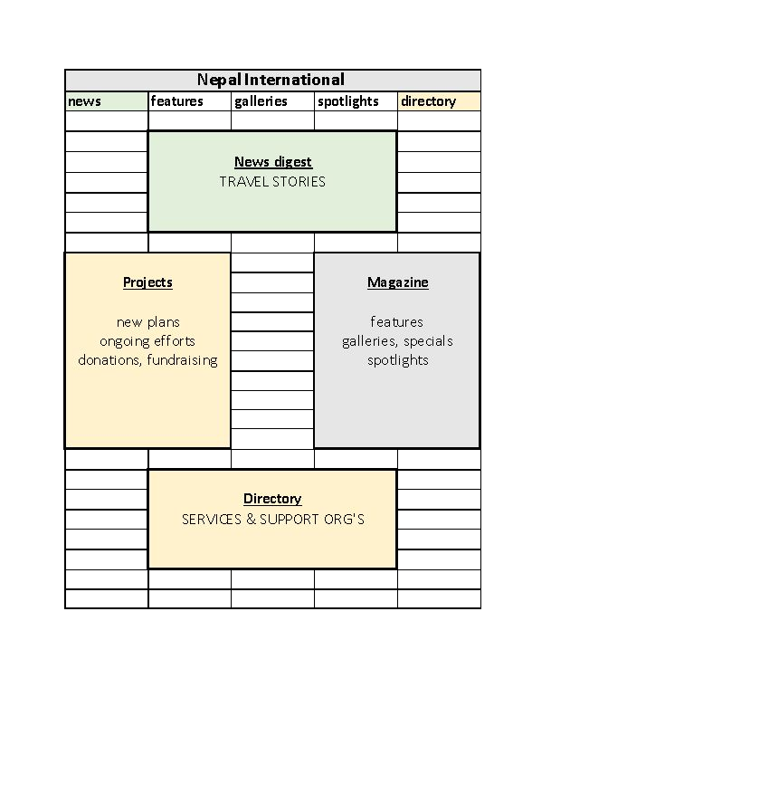
Platform = traffic square: visitors can choose different sections
Clockwise: four pockets of vital info & docu
News and travel – what’s going on, and where to go…
Magazine section – long read editorial content = features, in-depth background stories,including spotlights on interesting and innovative persons and players in the field of development, analysis, opinions, even video-blogs…
Directory – A to Z inventory of all useful organizations in the fields of service and support…
Projects, possibilities to engage – profiles of new and ongoing support projects, with invites to donate and/or participate…

Slide 4
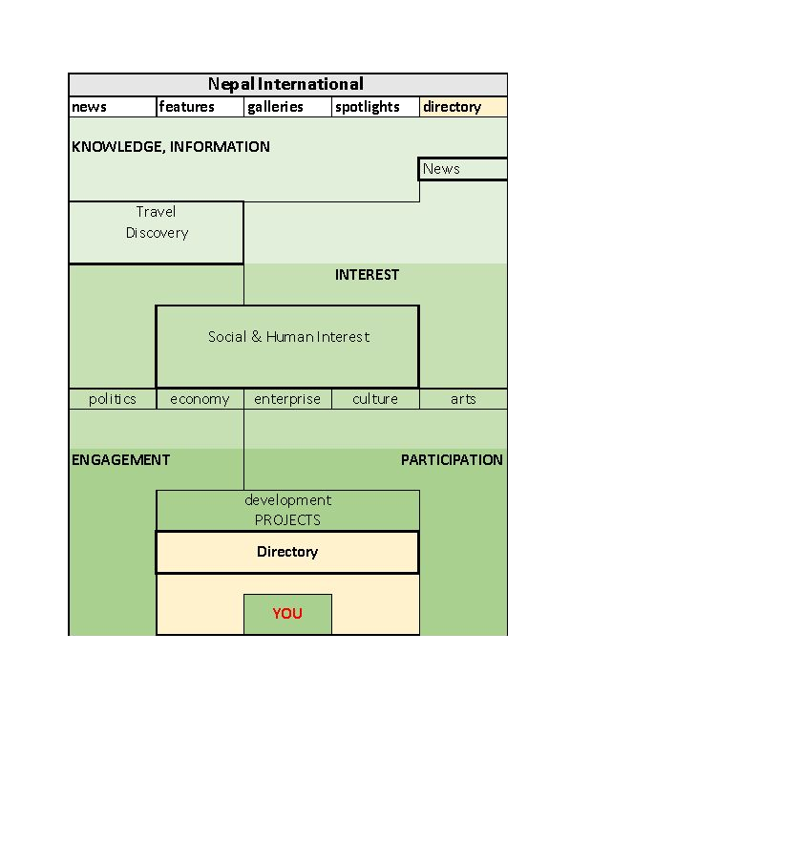
Nepal International:
from information to motivation
The ‘funnel’ = information and motivation flow
Getting acquainted with Nepal – through others who have been there, through information in a magazine, book or on the internet, often culminating in a first visit…
Falling in love – you either hate or love Nepal and the people who live there…
Realising the need for support – unmistakeable differences in the overall quality of life…
Feeling a wish to do something – time for reflection: what to do?
Reconnaissance & research – what is needed, who does what, where do I fit in?
Getting informed and developing deep interest – ‘insight’ leads to more understanding of social dynamics and developments plus a grip on your preferences…
Getting engaged and partake – through finding the right goal and/or support group…

Slide 5
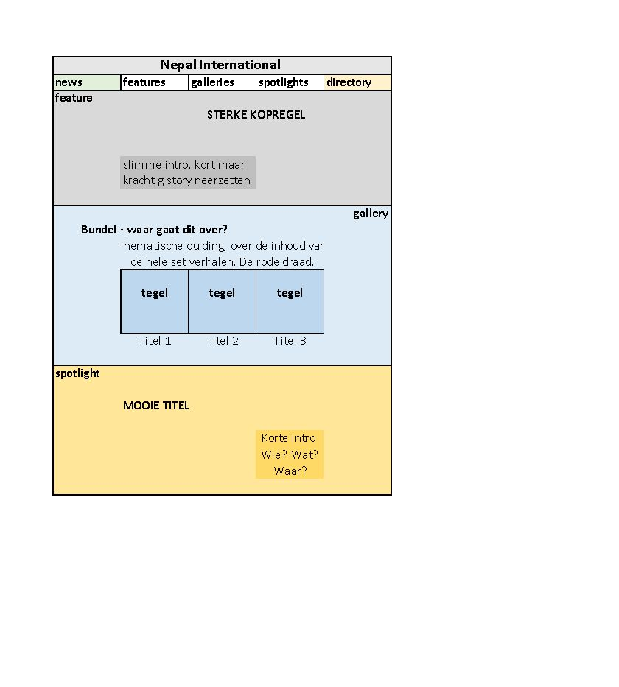
Nepal International – formula
Editorial components
Fresh feature articles – informative background articles zooming in on current affairs, human interest, economical aspects, innovative trends et cetera…
Galleries or specials – in-depth bundles of articles around a specific theme, or thorough investigative journalism, great photo essays or even video and film…
Spotlights – interesting, innovative persons or parties, always involved in one way or another with ‘development’ in Nepal…

Slide 6
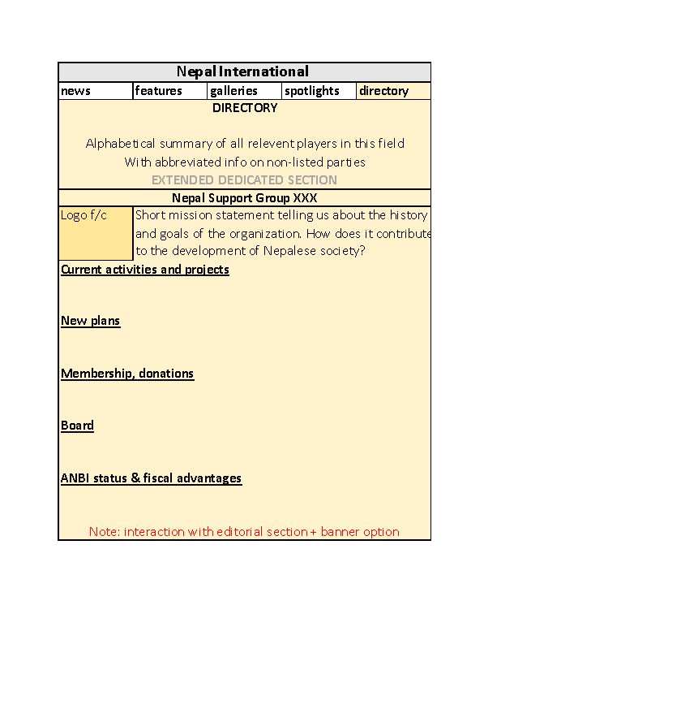
Comprehensive directory: the world of social support and innovative enterprise
Exposure and directory
Crowdfunding tool – an area where visitors can inspect and select initiatives they want to support and donate directly…
Agenda – an open-source ‘billboard’ for public events…
Directory – will become the alphabetic listing of all relevant players in the sphere of Nepalfriendly activities: support groups, reliable travel agents and trekking companies, affordable and pleasant hotels, restaurants and diners, useful lodges…
Dedicated space for NFN-members – each NFN-member has the option to showcase essential data and activities…
Donation promotion – NFN-members may employ ‘pop-up banners’ to promote membership and/or donations to specific projects…

Slide 7
Nepal International – timetable, subscriptions
Next steps
Groundwork – qualitative research, business plan, funding, building the editorial team, design, realization/programming of the website, marketing tools in place…
Test phase - preview of an operational prototype to a restricted test group…
NOTE Interested in the test? – pls give your email address to me, Albertine or Renate
Listbuilding – preparing initial readership list, through contacting the network and desk research
Launch – going public on-line, we aim to be ‘live’ by October 1…
Group-sub – Registered NFN participants get a free subscription with unlimited access rights for their members plus a dedicated entry in the Directory…
Single subscriptions – at a price of 26,- Euro per year…

